Slide 1
Sparks foundation Web Development and designing internship
Misba Sheikh

Slide 2
Task 3 Payment Gateway
Misba Sheikh

Slide 3
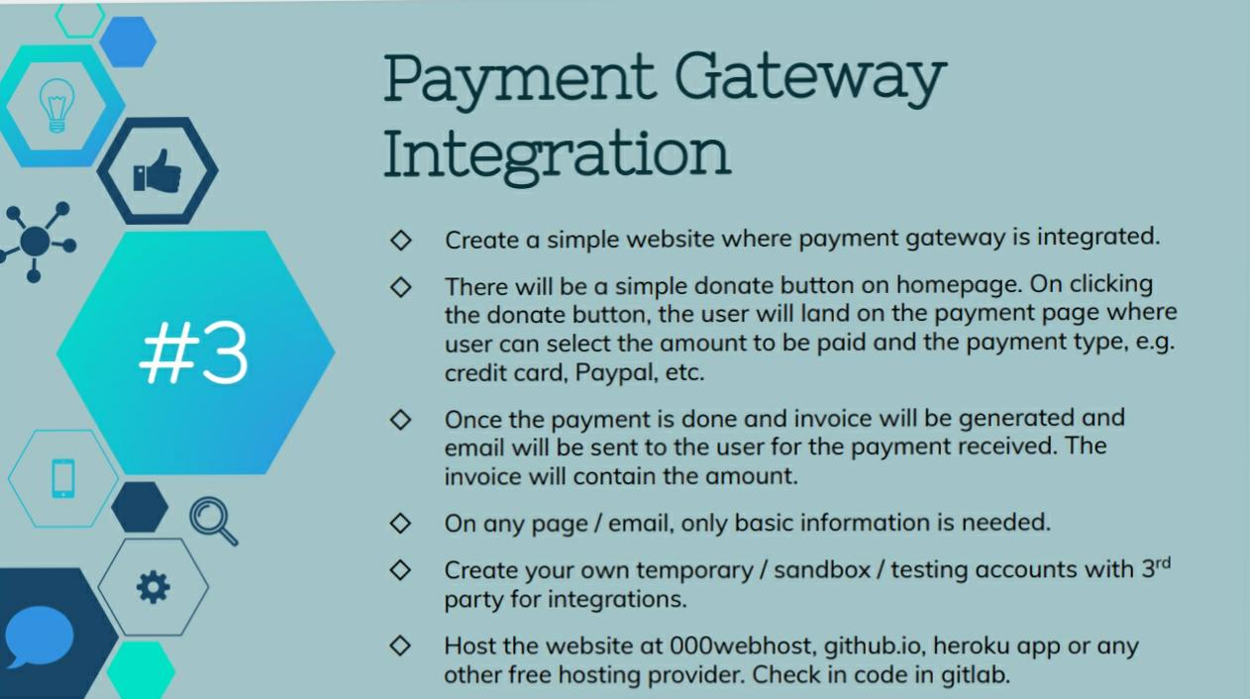
Misba Sheikh

